Slide 1

Overview of Spark
Let’s learn something!

Slide 2
Python and Spark
Before we begin the setup and coding with Python and Spark, let’s discuss what Spark is in the context of Big Data.
We’ll begin with a general explanation of what Big Data is and related technologies.

Slide 3
Big Data Overview
What is “Big Data”?
Explanation of Hadoop, MapReduce,and Spark
Local versus Distributed Systems
Overview of Hadoop Ecosystem
Overview of Spark

Slide 4
Big Data
Data that can fit on a local computer, in the scale of 0-32 GB depending on RAM.
But what can we do if we have a larger set of data?
Try using a SQL database to move storage onto hard drive instead of RAM
Or use a distributed system, that distributes the data to multiple machines/computer.

Slide 5

Local versus Distributed
Local
Distributed

Slide 6
Local versus Distributed
Core
Core
Core
Core
Core
Local
Core
Core
Core
Core
Core
Core
Distributed

Slide 7
Big Data
A local process will use the computation resources of a single machine
A distributed process has access to the computational resources across a number of machines connected through a network

Slide 8
Big Data
After a certain point, it is easier to scale out to many lower CPU machines, than to try to scale up to a single machine with a high CPU.
Distributed machines also have the advantage of easily scaling, you can just add more machines

Slide 9
Big Data
They also include fault tolerance, if one machine fails, the whole network can still go on.
Let’s discuss the typical format of a distributed architecture that uses Hadoop

Slide 10
Hadoop
Hadoop is a way to distribute very large files across multiple machines.
It uses the Hadoop Distributed File System (HDFS)
HDFS allows a user to work with large data sets
HDFS also duplicates blocks of data for fault tolerance
It also then uses MapReduce
MapReduce allows computations on that data

Slide 11
Distributed Storage - HDFS
Name Node
CPU
RAM
Data Node
Data Node
Data Node
CPU
RAM
CPU
RAM
CPU
RAM

Slide 12
Distributed Storage - HDFS
HDFS will use blocks of data, with a size of 128 MB by default
Each of these blocks is replicated 3 times
The blocks are distributed in a way to support fault tolerance
Name Node
CPU
RAM
Data Node
Data Node
Data Node
CPU
RAM
CPU
RAM
CPU
RAM

Slide 13
Distributed Storage - HDFS
Smaller blocks provide more parallelization during processing
Multiple copies of a block prevent loss of data due to a failure of a node
Name Node
CPU
RAM
Data Node
Data Node
Data Node
CPU
RAM
CPU
RAM
CPU
RAM

Slide 14
MapReduce
MapReduce is a way of splitting a computation task to a distributed set of files (such as HDFS)
It consists of a Job Tracker and multiple Task Trackers
Job Tracker
CPU
RAM
Task Tracker
Task Tracker
Task Tracker
CPU
RAM
CPU
RAM
CPU
RAM

Slide 15
MapReduce
The Job Tracker sends code to run on the Task Trackers
The Task trackers allocate CPU and memory for the tasks and monitor the tasks on the worker nodes
Job Tracker
CPU
RAM
Task Tracker
Task Tracker
Task Tracker
CPU
RAM
CPU
RAM
CPU
RAM

Slide 16
Big Data
What we covered can be thought of in two distinct parts:
Using HDFS to distribute large data sets
Using MapReduce to distribute a computational task to a distributed data set
Next we will learn about the latest technology in this space known as Spark.
Spark improves on the concepts of using distribution

Slide 17
Spark
This lecture will be an abstract overview, we will discuss:
Spark
Spark vs MapReduce
Spark RDDs
Spark DataFrames
Spark is not compared with Hadoop, rather with MapReduce

Slide 18
Spark
Spark is one of the latest technologies being used to quickly and easily handle Big Data
It is an open source project on Apache
It was first released in February 2013 and has exploded in popularity due to it’s ease of use and speed
It was created at the AMPLab at UC Berkeley

Slide 19
Spark
You can think of Spark as a flexible alternative to MapReduce
Spark can use data stored in a variety of formats
Cassandra
AWS S3
HDFS
And more

Slide 20
Spark vs MapReduce
MapReduce requires files to be stored in HDFS, Spark does not!
Spark also can perform operations up to 100x faster than MapReduce
So how does it achieve this speed?

Slide 21
Spark vs MapReduce
MapReduce writes most data to disk after each map and reduce operation
Spark keeps most of the data in memory after each transformation
Spark can spill over to disk if the memory is filled

Slide 22
Spark RDDs
At the core of Spark is the idea of a Resilient Distributed Dataset (RDD)
Resilient Distributed Dataset (RDD) has 4 main features:
Distributed Collection of Data
Fault-tolerant
Parallel operation - partioned
Ability to use many data sources

Slide 23

Spark RDDs

Slide 24
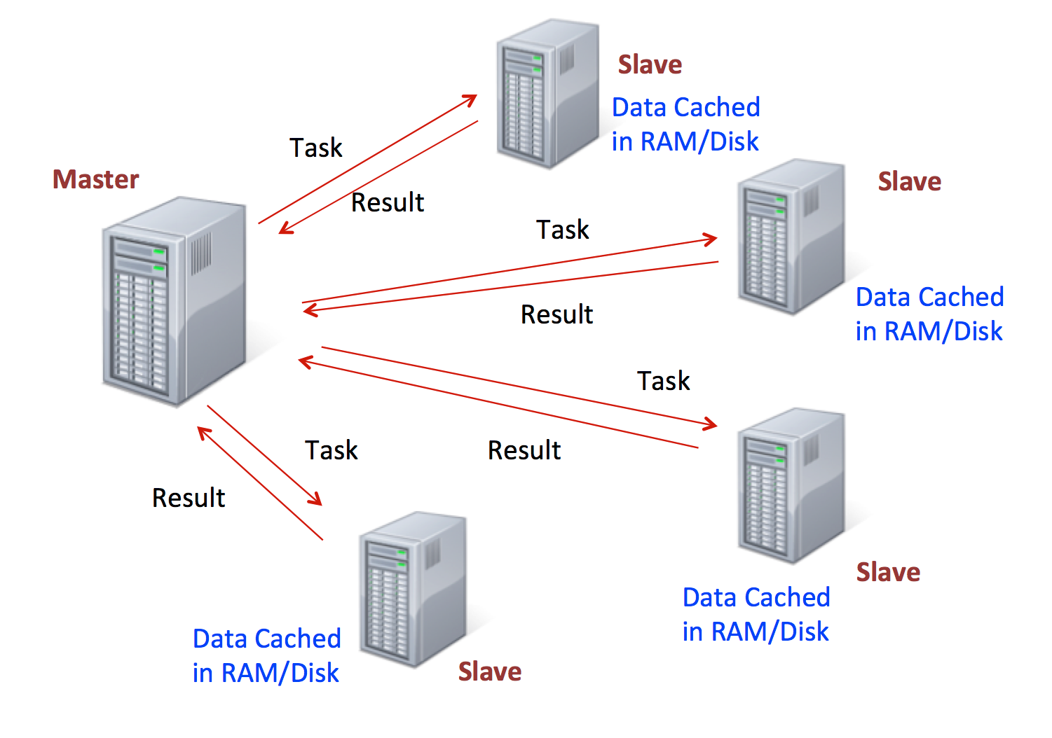
Spark RDDs

Slide 25
Spark RDDs
RDDs are immutable, lazily evaluated, and cacheable
There are two types of Spark operations:
Transformations
Actions
Transformations are basically a recipe to follow.
Actions actually perform what the recipe says to do and returns something back.

Slide 26
Spark RDDs
This behaviour carries over to the syntax when coding.
A lot of times you will write a method call, but won’t see anything as a result until you call the action.
This makes sense because with a large dataset, you don’t want to calculate all the transformations until you are sure you want to perform them!

Slide 27
Spark RDDs
When discussing Spark syntax you will see RDD versus DataFrame syntax show up.
With the release of Spark 2.0, Spark is moving towards a DataFrame based syntax, but keep in mind that the way files are being distributed can still be thought of as RDDs, it is just the typed out syntax that is changing

Slide 28
Spark RDDs
We’ve covered a lot!
Don’t worry if you didn’t memorize all these details, a lot of this will be covered again as we learn about how to actually code out and utilize these ideas!

Slide 29
Spark DataFrames
Spark DataFrames are also now the standard way of using Spark’s Machine Learning Capabilities.
Spark DataFrame documentation is still pretty new and can be sparse.
Let’s get a brief tour of the documentation!

Slide 30
http://spark.apache.org/

Slide 31
Python and Spark

